Slide 1

Year 6
Parents’ Information Evening
Friday 6th September

Slide 2
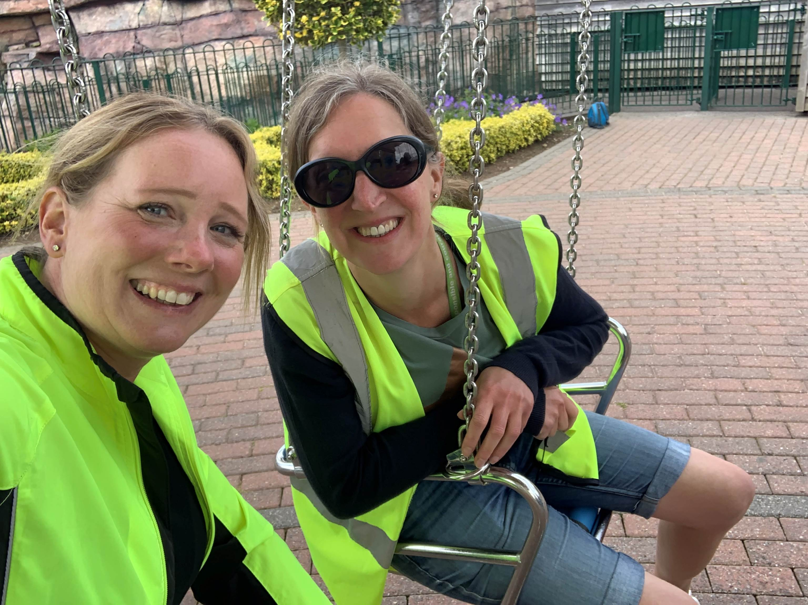
Who are we?
Mrs Holt - Class teacher – In class Mon-Thurs
Mrs Holiday – Class TA /HLTA– In class on Fridays

Slide 3
Organisation and Routines
8.45 Children welcomed into class.
8.45 Register/ Start of day learning activities.
10.20-10.35 – Breaktime
12.00-1.00 – Lunchtime
3.15 End of day
What will the children need?
School bag
Lunch box
Drinks bottle
Reading book

Slide 4
Promoting Positive behaviour
REWARDS
Praise points
Celebration Assembly
Individual responsibilities
Visits to Mrs Davids
Messages home
CONSEQUENCES
Reminders/warnings given
Yellow cards
Red cards
Red card club with Mrs Davids or Mrs Holt
We will keep parents informed if we feel that behaviour has changed, become persistently disruptive or an unacceptable event has taken place.

Slide 5
Autumn Term Timetable
A Typical day
Registration
Phonics/spelling
Mathematics
BREAK
English
Guided Reading
LUNCH
Fluency/catch-up work
History or Geography
PE or PSHE or Science or Art
Our PE DAY will be on a Thursday.
PE kits will continue to be worn to school – black shorts, white t-shirts, black hoodie/zip-up jacket.

Slide 6
Reading
Even though your child is now in Year 6, please keep encouraging daily reading at home. Children love having stories read to them so please do not feel because they are in Y6, this needs to stop – it doesn’t! ☺
Reading records
Please ensure your child’s reading record is being filled in and signed each time they read. They need to bring this in every Thursday for a chance to be entered into the GOLDEN TICKET raffle

Slide 7
Additional learning support
Children who need additional support with their learning may work with a different teacher or teaching assistant for pre-planned sessions of support across the week.
Sometimes children will go to a small group to work for phonics or spelling interventions. Their progress will be discussed with you at parents’ evenings.
These pre-planned sessions are organised after liaison between the class teacher, teaching assistants and the SENDCO.

Slide 8
Homework
In Year 6, homework consists of:
Daily reading
Learning weekly spelling words
Maths - arithmetic based work
SPAG (spelling, punctuation and grammar work)
Homework will be set on a Friday to be in on the following Thursday.
Homework should take approximately one hour. If your child is taking longer or needing extra help, please do let me know.
Homework club will be available on a
Monday after school.

Slide 9
OPAL
At breaktime and lunchtime, children have the opportunity to use the OPAL (Outdoor Play And Learning) equipment. If they wish to play on the grass they will need to have wellies in school. The field will be accessible all year but wellies must be worn on it.

Slide 10
Communication
We use the Arbor app to communicate messages/letters to parents. If you haven’t signed up to this/aren’t familiar with this, please speak to one of the office ladies who will happily help you set it up.
Urgent messages need to go to the office and this will be passed onto the class teacher.
There is always a member of staff on the gate each morning for messages.

Slide 11
Looking Ahead
Swim For Charity – Saturday 12th October -12.15 – 1.15.
Sex Education – this will be included in our curriculum towards the end of the summer term – I will inform you about when we will begin this unit of work.
Christmas performance at the church – Tuesday 17th December
SATs 2024 - Monday 13th May to Thursday 16th May
Transition - there will be a transition day in July along with many other opportunities to visit
new schools.

Slide 12
Trips/Experience Days
Autumn:
Winchester Science Centre – Focusing on the heart and circulatory system. (£10)
Trip to Wareham – Fair Trade talk/Co-op (November)
Spring:
Trip to Studland beach – Geography trip – Climate Change (March) (£2.50)
Summer:
Dragon’s Apprentice
Activity week – w/b 16th June including sleepover 20-21June. (£125.)

Slide 13
Other Y6 info
Hoodies
Leavers’ party – Friday 18th July
Parental support to raise money

Slide 14
Any Questions?

