Slide 1

8.45am before phonics activity
Write a sentence about this picture.

Slide 2
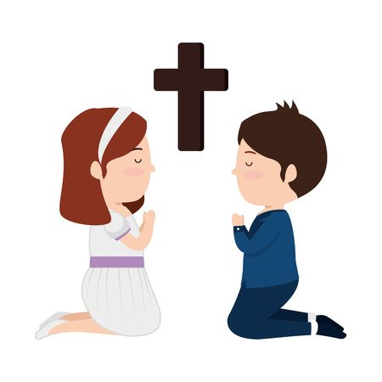
Dear God,
We’ve arrived, we are ready
We are happy we are strong,
We are learners, we are teachers help us all to get along.
Amen

Slide 3
Phonics

Slide 4
What is a…
Phoneme - a sound
Grapheme – sounds written down
Digraph – 2 letters that make 1 sound
Trigraph – 3 letters that make 1 sound

Slide 5
ay | ea | ie | ue
oy | ir | ou | wh
ph | ew | aw

Slide 6
Read the High frequency words
made | came | these

Slide 7
Read the tricky words
Can you spell…
Which part tricks us out?
like | one

Slide 8
Read the words – Debug
launch yawn
crawl haul

Slide 9
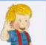
Our new sound is
a-e

Slide 10
Our new grapheme today, makes the same sound as ai, ay. Can you spot the difference?
ai ay a-e
We call this a ‘split diagraph.’ We usually find it in the middle of words.
bake came take
There is a letter between the ‘a’ and the ‘e’.
The a says ai. The e is silent.

Slide 11

Letter formation practise: a-e
Using letterjoin patter

Slide 12
Read the word
bake

Slide 13
Read the word
name

Slide 14
Read the word
take

Slide 15

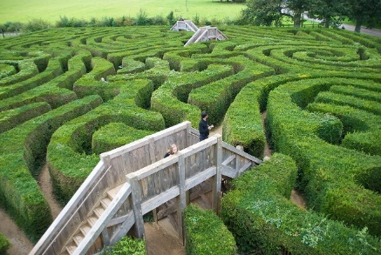
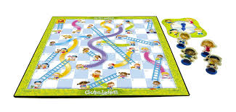
Write

Slide 16
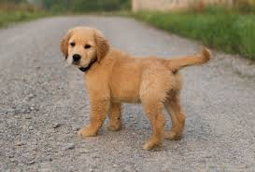


Read the sentence - Debug the sentence together
Can a dog be lame?
Yes
No

Slide 17
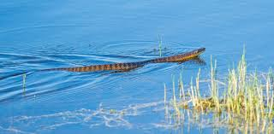
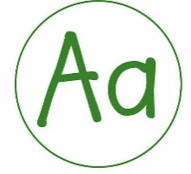




Check you have…
sp

Slide 18
Write a sentence. Look at the snake in the lake!.

